Slide 1
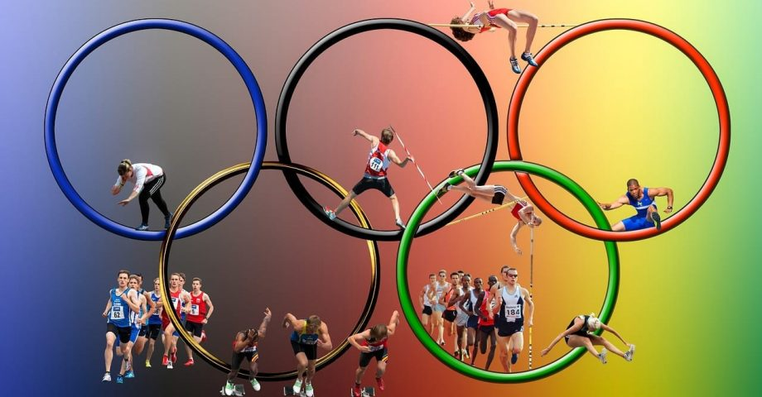
Analyzing the Olympics and its relevance to Egypt

Slide 2
Presented to you by:
Hamdy Mohamed
Lina Jamal Mahmoud
Mahmoud Sayed
Mohamed Ayman
Mohamed Gamal
Shorouk Salah

Slide 3
Table of content:
Motivation behind Project
Introduction about the Olympics
Project’s framework

Slide 4
Motivation behind the Project
Believing in the importance of data analysis and seeing the famous Paris 2024 both the events and the results after; it has come to our minds that there is a growing need to analyze the data to better understand the top performing and why they are the top. In addition, to highlight Egypt’s performance throughout the years.

Slide 5
Objective of the Study:
The primary objective of this study is to perform a comprehensive analysis of Olympic data to:
Identify Trends in Top Performing Nations:
Analyze medal counts and event-specific performances across various Olympic editions.
Explore the socio-economic, demographic, and sports-specific factors that contribute to the success of leading nations.
Egypt’s Performance Analysis:
Track Egypt’s participation, progress, and performance across different Olympic editions.
Highlight sports where Egypt has excelled or underperformed.
Provide insights into the potential areas where Egypt could improve in future Olympic Games.
Understand Patterns Over Time:
Examine how the performance landscape has changed across different Olympic events.
Analyze the evolution of new sports and events, and their impact on national rankings.
Support Strategic Decision-Making:
Provide recommendations based on the data insights to help policymakers focus on promising sports and talent development strategies.

Slide 6
Introduction about the Olympics
The modern Olympic Games were revived in 1896 by Frenchman Pierre de Coubertin, who aimed to foster international goodwill through sport. The first modern Olympics took place in Athens, featuring 13 nations and 43 events.

Slide 7
Introduction about the Olympics
Since then, the Olympics have grown tremendously, with the Summer and Winter Games now held every four years, alternating every two years. The Olympics have seen the addition of numerous sports, expanded participation, and significant global media coverage, making them one of the largest sporting events in the world. Notable moments include Jesse Owens' triumph in 1936, the Munich massacre in 1972, and the introduction of professional athletes in the 1992 Barcelona Games. Today, the Olympics symbolize athletic excellence and international cooperation.

Slide 8
Project’s Framework
We have divided the project into milestones each were done by a pair of us, which included:
Data preparation
Measures
Visualization and presentation

Slide 9
Data Preparation
Done By: Hamdy Mohamed& Mohamed Ayman
That’s why the preparation of data included:
Data collection
Data cleaning
Data transformation and formatting
Thoroughly examining the data

Slide 10
Data Sources:
1-Kaggle Dataset
2-Egyptianolympic.org
3-olympedia.org

Slide 11
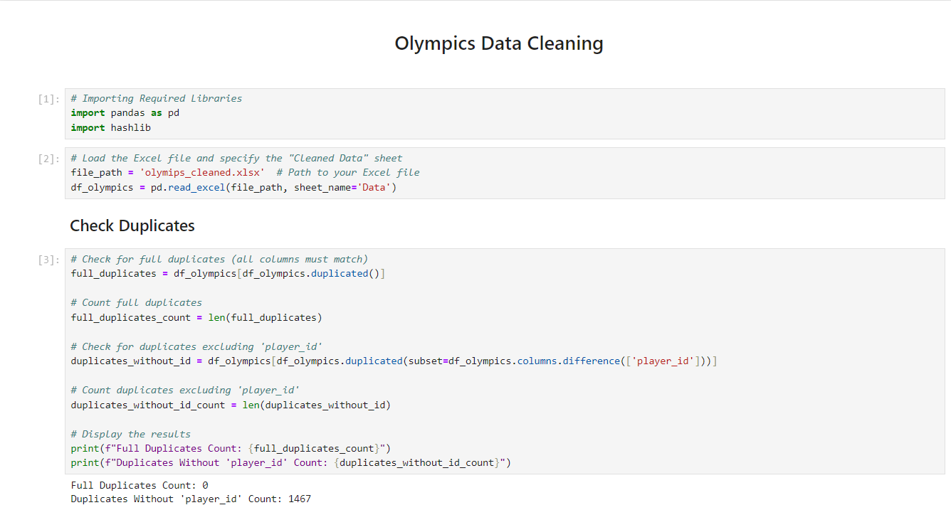
Data Preparation

Slide 12
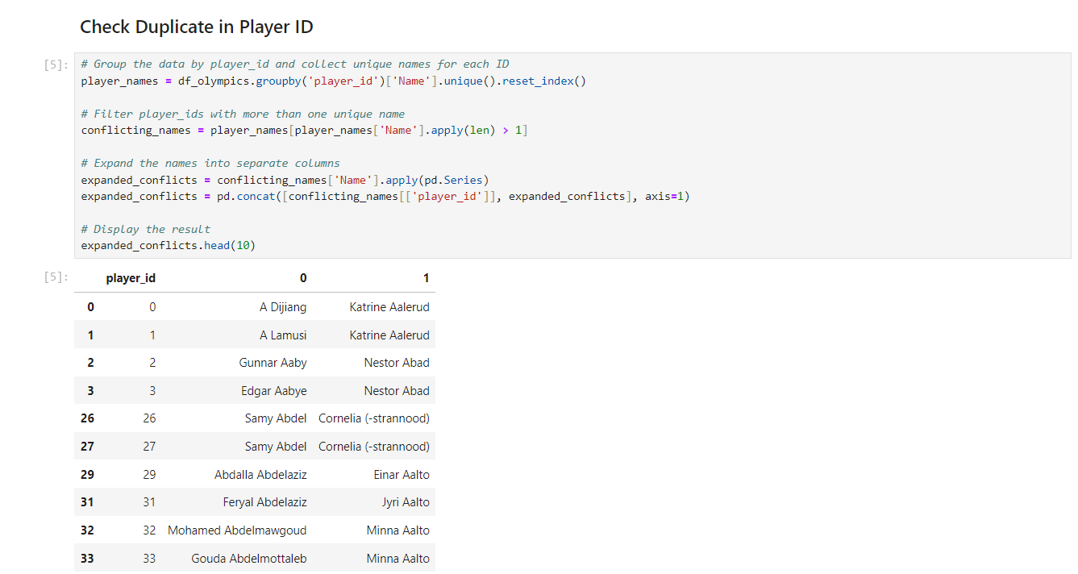
Data Preparation

Slide 13
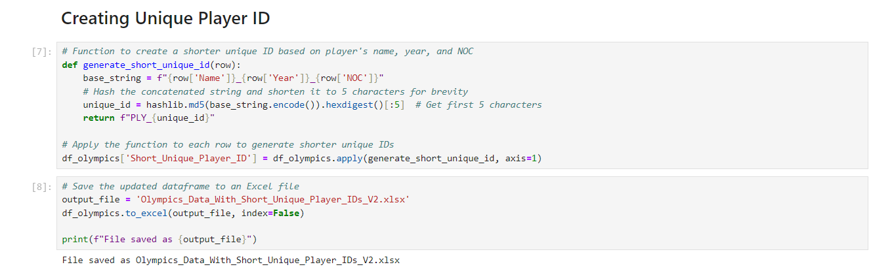
Data Preparation

Slide 14
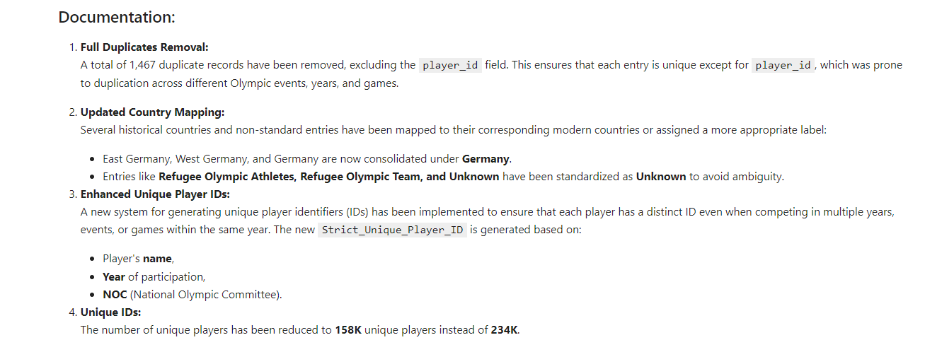
Data Preparation

Slide 15
Measures
Done By: Mahmoud Sayed & Mohamed Gamal
Measures in data analysis are essential for quantifying and comparing data, guiding informed decision-making and strategy. They enable performance evaluation against benchmarks, support statistical techniques, and simplify complex information for clearer communication. Ultimately, measures transform raw data into actionable insights, enhancing the effectiveness of analysis.

Slide 16
Measures
Done By: Mahmoud Sayed & Mohamed Gamal
Data standardization
Define objectives of the project
Choose appropriate measures’ types

Slide 17
Visualization and Presentation
Done By: Lina Jamal & Shorouk Salah
Data visualization is vital as it converts complex datasets into clear, graphical representations, making it easier to identify patterns and insights. It enhances communication, allowing stakeholders to quickly grasp significant information and aiding in better decision-making. Engaging visuals also enhance storytelling with data, fostering a deeper understanding among diverse audiences. Overall, effective data visualization empowers organizations to leverage insights for strategic planning and action.

Slide 18
Visualization
Presentation
Done By: Shorouk Salah
Done By: Lina Jamal
Visualization was done using PowerBI, which included multiple pages showcasing the Olympics:
Home page and Dashboard
Continents
Countries
Athletes
Egypt
2028

Slide 19
Visualization
Done By: Lina Jamal
Interactive Features and Drilldowns: Users can interact with the data using the following features:
Country and Year Slicers: Allow users to filter the data by specific countries and Olympic years.
Drilldown by Continent and Country: Enables deeper exploration from continent-level to country-specific medal counts and participation rates.
Sport-wise Filtering: Users can filter medal counts and athlete participation by specific sports.
Tooltips: Provide additional insights when hovering over medals and participation charts.
. Field Parameters: Users can toggle between viewing total medals, gold medals, and participation count on the same chart using a single field parameter.
. Bookmarks: Used to create a navigation experience that moves users between report sections.

Slide 20
Limitations
1. Data Source Diversity and Transformation Requirements:
The data was collected from multiple sources, which necessitated extensive transformation and standardization to ensure consistency across the dataset.
2.Winter Olympics Data Exclusion:
The analysis is limited to Summer Olympics data due to the unavailability of comprehensive Winter Olympics datasets.
3.Assumptions for 2028 Predictions:
Predictive models assume consistent participation rates and no major geopolitical disruptions that could affect medal counts.

Slide 21
Future Enhancements
Advanced Predictive Analytics with Machine Learning Integration
Incorporating External Datasets (e.g., Athlete Training Data, Economic Indicators)
Social Media Sentiment Analysis

Slide 22
Thank you

